Slide 1

The OSS Crew
Chengkai Yang
Christopher Wong
Hrishikesh Panchbhai
Jayalakshmi Vaidayanathan
Vishal Reddy Gopu

Slide 2
Table of Contents
Business Introduction
Problem Statement
The Solution
Personas
User Stories
Business Requirements
High-Level Requirements
SDLC Model
Risks and Mitigations

Slide 3
Our Business
Our vision is to make health management easier and faster for patients by connecting them with doctors and pharmacies
The compassionate care provided by our doctors, nurses and other staff is a key to our success.
Our expertise covers all specialties, from cancer to women's health.
Risk and Mitigations Healthify is recognized for its advanced patient care and technology.

Slide 4

Existing System
Health management portal using MySQL
Manual Process includes :
Patients forms
Set up Appointment through telephone
Paper-based lab reports to be collected in person
Provides facilities to maintain Patients, Doctors information
https://www.google.com/search?q=mysql&source=lnms&tbm=isch&sa=X&ved=0ahUKEwjdqdKx3LbbAhWPAHwKHWdhA8MQ_AUIDCgD&biw=1707&bih=735#imgrc=gdEfg_wN9iKVfM:

Slide 5
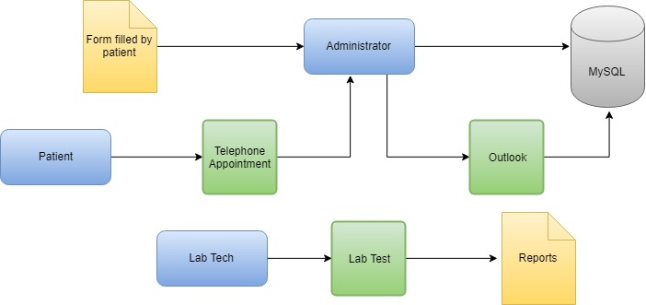
Existing System

Slide 6
Business requirement
The new system will provide below mentioned features:
360- degree profile view
Provide doctors with accurate past medical records of patients to provide better diagnosis and treatment
Online Lab test result Management
Provide online facilities for patients and doctors to access the patient’s lab test results online
Virtual appointment
Scheduling an appointment for a skype visit. Conversing on a private chat with Doctor/Patients
Connecting Pharmacy
A common platform to connect patients to pharmaceuticals to help patients get their medicines hassle free

Slide 7
Mission Statement
Scale up the business features
Better Service for our patients
Implement advanced technology to organize sensitive patient data
Identifying revenue streams via medical and business trends using analytics

Slide 8
Problem Statement
Current Process is a manual process
No centralization
Many Physical documents.
No feature to store video recordings in MySQL
Images of Prescriptions and Lab reports cannot be stored in MySQL

Slide 9
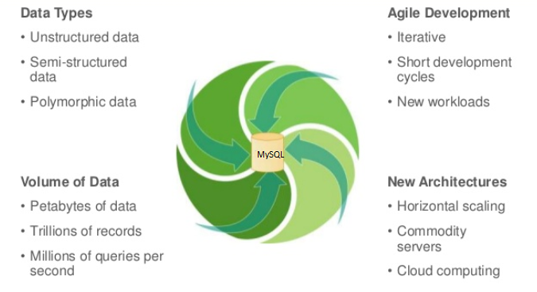
Challenge With MySQL

Slide 10
The Solution - MongoDB

Slide 11
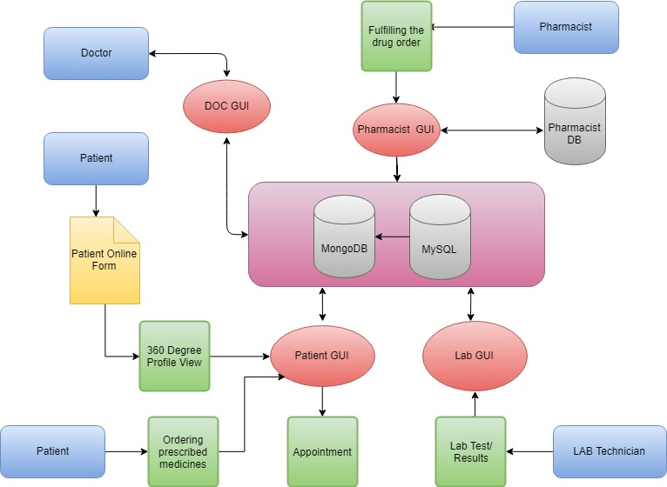
Proposed System

Slide 12
Why MongoDB?
MongoDB is a free and open-source cross-platform
NoSQL database program, uses JSON-like documents with schemas
Supports dynamic schema design, allowing the documents in a collection to have different fields and structures
Automatic sharding enables data in a collection to be distributed across multiple systems for horizontal scalability as data volumes increase.

Slide 13
Comparison
NAME | MongoDB | Cassandra | MySQL
Description | One of the most popular document stores | Wide-column store based on ideas of BigTable and DynamoDB | Widely used open source Relational Database Management System
Primary database model | Document Store | Wide Column Store | Relational DBMS
Implementation Language | C++ | JAVA | C and C++
Server Operating System | Linux OS X Solaris Windows | BSD Linux OS X Windows | FreeBSD Linux OS X Solaris Windows
https://www.linkedin.com/pulse/real-comparison-nosql-databases-hbase-cassandra-mongodb-sahu/

Slide 14
Comparison continued..
NAME | MongoDB | Cassandra | MySQL
Data Scheme | Although Schema Free, documents of the same collection often follow same structure | Schema Free | Fixed Schema
Secondary Indexes | Supported | Restricted | Supported
Triggers | Not Supported | Supported | Supported
Foreign Keys | No (typically not used, however similar functionality with) | NO | YES
In Memory Capabilities | Supported | Not Supported | Supported

Slide 15
Comparison continued..
In MongoDB, data is represented in a collection of JSON documents while in MySQL, data is in tables and rows. JSON documents can compare to associative arrays when using PHP and directory objects when using Python.
MongoDB has a Map Reduce feature that allows for easier scalability. This means you can get the full functionality of MongoDB database even if you are using low-cost hardware.
We do not have to come up with a detailed DB model with MongoDB because of is non-relational.

Slide 16
Comparison continued..
MongoDB main purpose is to assist in data storage and the solution can indeed store documents on the World Wide Web.
One of its most outstanding features is data storage in a dynamic schema.

Slide 17
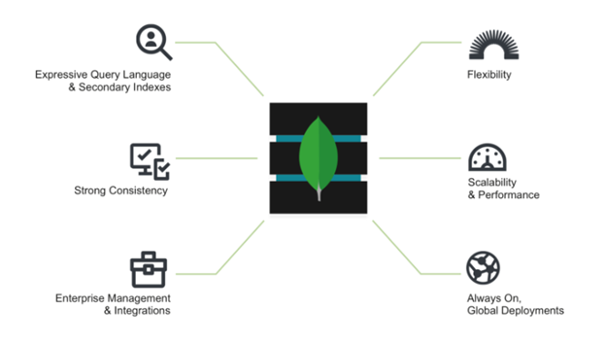
MongoDB - Architecture
https://www.mongodb.com/mongodb-architecture

Slide 18
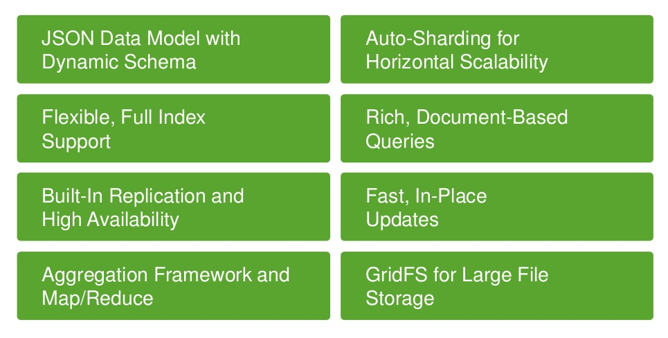
MongoDB: Capabilities
Flexible Data Model
Scalability and Performance
Always-On Global Deployments

Slide 19
Upstream
MongoDB dependencies v3.6:
Apache - Provides back end GUI support
Java - Allows for creation of Javascript queries
MapReduce - Provides data aggregation features
WiredTiger - Internal data storage method for documents
1
2
3
4
1https://en.wikipedia.org/wiki/MongoDB https://docs.mongodb.com/manual/applications/drivers/index.html https://www.mongodb.com/products/spark-connector
2 https://docs.mongodb.com/manual/applications/drivers/index.html
3 - https://www.zdnet.com/article/mongodb-3-0-gets-ready-to-roll-with-wiredtiger-engine-onboard/
4 https://docs.mongodb.com/manual/core/map-reduce/

Slide 20
Downstream
MongoDB Modules v3.6:
Compass - Provides GUI support for data visualization, also API support for 3rd party management software
Atlas - Provides cloud support and management for a distributed virtualized shard deployment
Stitch - Back end support and integration for external applications along with API access, also provides application management services.
1
2
3
1 https://www.mongodb.com/products/compass
2 https://www.mongodb.com/cloud/atlas
3 https://www.mongodb.com/cloud/stitch

Slide 21
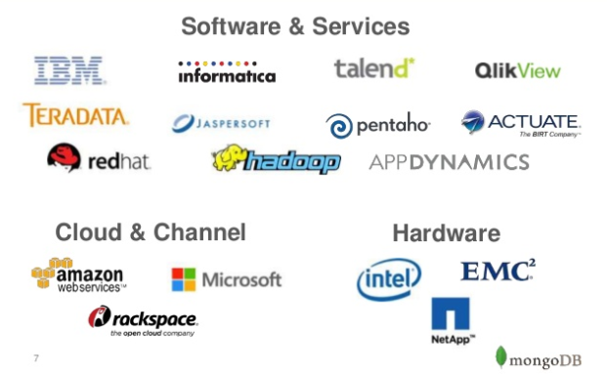
Mongo Partners
https://www.slideshare.net/mongodb/how-insurance-companies-use-mongodb

Slide 22
MongoDB Deployment
MongoDB can run on Windows, Linux, Solaris, and FreeBSD
Internal Java environment with Apache dependencies
Supports web GUI
Sharding - allows for distributed data and increased resiliency of the system along
with increased throughput with more simultaneous transactions.
1
1
1 https://www.mongodb.com/mongodb-architecture
2 https://docs.mongodb.com/manual/sharding/index.html

Slide 23
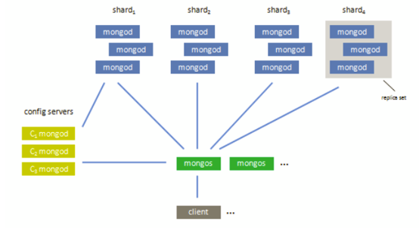
Sharded Architecture
Sharded deployment example
IMG Source: https://blog.serverdensity.com/automating-partitioning-sharding-and-failover-with-mongodb/
Notes:
https://www.researchgate.net/figure/MongoDB-Architecture_fig2_289519350

Slide 24
Platform Support
Healthify intends on hosting it’s own physical servers running on VMs in a sharded
deployment on Windows servers to maintain physical control of the data. Long term options for offsite backup can be an AWS server with dedicated resources depending on future cost analysis.
Cloud environments - AWS EC2, GCP, MS Azure
dotCloud, Rackspace, Redhat Openshift, VMware Cloud Foundry
1
1
1 https://www.mongodb.com/mongodb-architecture

Slide 25
Project Scope
360- degree profile view:
Using MongoDB, we can add a new feature to our application that provides a complete view of the patient’s profile, aggregating patient’s medical bills, prescriptions, lab test results and other relevant history. It can serve more patients in less time.
1
1

Slide 26
Project Scope
Online Lab test result Management:
Using MongoDB, we can upload large test results which will be available for patients and doctors under patients profile.
Both Patients and Doctors can access them online for referring during the patients appointment
1
1

Slide 27
Project Scope
Virtual appointment:
This will allow patients to have an appointment with a doctor online from anywhere, as per their convenience. Also allow patients to save the appointment for future reference.
1
1

Slide 28
Project Scope
Connecting Pharmacy:
This will allow patients to have an appointment with a doctor online from anywhere, as per their convenience. Also allow patients to save the appointment for future reference.
1
1

Slide 29
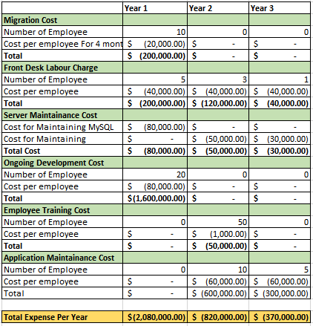
Return on Investment

Slide 30
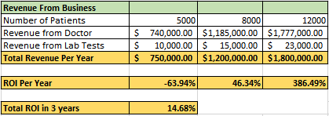
Return on Investment

Slide 31
Return on Investment

Slide 32
Return on Investment

Slide 33
Return on Value
Value Factors | Value Source | Value
Competitive Edge | Better market position | Since we are first in the market to launch virtual appointments the business value of the company increases. Increased revenue as seen in ROI
Optimization | Service Optimization | Our application is optimized for all web browsers and for mobile platforms.

Slide 34
Return on Value
Value Factors | Value Source | Value
Patient Experience Management | Satisfied Customers | Improve customer satisfaction levels by providing online appointment facilities. Provide access to patient medical history under one click Increase customer retention by providing quality service
Service Improvement | Online facilities | Customers can send prescription to the pharmacists directly through the application which reduces the wait time. Customers can reschedule appointments without calling the doctors office.

Slide 35
Stakeholders
Patients - Patients can converse with their care providers, access medical records, scheduling, billing, prescriptions, and other features
Medical Personnel - Doctors and Nurses have access to patient medical records, converse with the patient, and can request services like lab, medication, or referrals to specialists.
Lab Technician- Lab technicians can receive lab test requests and upload results

Slide 36
Stakeholders
Pharmacist - Local stores that are tied into the system to receive prescriptions and also for mail delivery and online renewal
Administrator - Hospital staff performing billing, scheduling, and other administrative functions
IT Personal - Ensures HIPPA compliance and maintains administration of the system, user accounts, and permissions

Slide 37
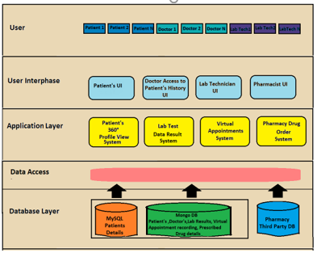
Architecture

Slide 38
Personas

Slide 39
Patient - Lara Brown, 44
Description
Marketing manager @ medium-sized tech company
Married, 3 kids
Inflexible schedule, some travel required
Goals
Have access to Healthify serves at her convenience
Busy with research and cannot always remember her medical and prescription history.
Would like her and her doctor to have easy access to medical history
Believes advancements in video calling tech can enable her to consult virtually
w/doctor and have an archive of that call
Would like prescriptions delivered home, like she does with groceries

Slide 40
Doctor - Thomas Vance, 31
Description
New family physician at Healthify, serves Brown family
Loves working at Healthify and serving patients
Thinks current documentation system is outdated and frustrating, “A mess of spaghetti.”
Goals
Have a more unified platform to track patients and documentation
Have a clearer view of patient’s medical history and needs with that documentation
Consult with patients virtually at their convenience
Quickly identify most convenient pharmacies to have fulfill prescriptions

Slide 41
Lab Tech - Jonah Woods, 24
Description
One of several lab techs at Healthify
Studying at medical school
Feels current system is outdated and that results should be handled digitally
Goals
Remove the need to have physical documents for lab results
Remove the need for those physical documents to be scanned into a flat file system

Slide 42
Pharmacist - Maria Samson, 37
Description
Works at local pharmacy branch serving patients from multiple hospitals and health
clinics, including Healthify
Pharmacy has implemented latest technologies to track and manage medicine supplies
Concerned that clinics that don’t update their own systems will waste patient’s time
sending them to pharmacies that can’t fulfill prescriptions
Goal
Have a system that can interface with her branch’s medicine inventory remotely,
so hospitals and clinics have a better idea of which pharmacies can
best fulfill requested prescriptions

Slide 43
User Scenarios

Slide 44
User Scenarios (Contd.)
Who | What | Why | Acceptance Test
Patient | Healthcare provider to have a clear idea of my medical history | To better fulfill my needs | On request, system will accept updates to profile from users of the system
Doctor | A complete view of my patient’s medical profile and history | To more efficiently diagnose their issues and prescribe medication | On request, system will provide and format all relevant data on a patient
Lab tech | See what tests are required and quickly update them with results | To help the doctor analyze the results | System will display requested tests for a patient and accept updates from the lab

Slide 45
User Scenarios (Contd.)
Who | What | Why | Acceptance Test
Patient/Doctor | To consult face-to-face over the internet and have an archive of that consultation | Convenience and future analysis | A virtual consultation is recorded and available for viewing after the consultation

Slide 46
User Scenarios (Contd.)
Who | What | Why | Acceptance Test
Doctor | Send a patient’s prescription to a pharmacy within our network and have it fulfilled | To ensure the patient is receiving their assigned medication
Patient | View my prescriptions on the Healthify service and have the medication delivered to my home | Convenience to fit my busy life
Pharmacist | View a patient’s full prescription history | To ensure there are no medical conflicts between medications

Slide 47
High-Level Requirements

Slide 48
Business Requirements
360-degree profile view
Online Lab Test Result Management
Virtual appointments
Connecting Pharmacies

Slide 49
High-Level Requirements
Functional | Non-Functional
System must integrate with existing Healthify MySQL Database | System will use middleware to collate data from MongoDB and MySQL databases
System must have partitioned permissions with regards to record access and updates | System will have a maintained permissions file using MongoDB “Users and Roles” that is kept at parity w/MySQL database via AD
System must be regularly backed up | System will dump daily database backups to vault machines (see Risks and Mitigations)

Slide 50
High-Level Requirements
Functional | Non-Functional
System must not allow remote modification of sensitive information | Remote access via web portal will have limited access to information Remote access to the database will be refused

Slide 51
High-Level Requirements -360-degree Profile View
Functional | Non-Functional
System must aggregate patient’s relevant medical history on demand Relevant medical history includes, but is not limited to: bills, prescriptions, operations, and lab results | System will accept and validate provided criteria from interested parties System will retrieve relevant patient data from MondoDB based on criteria System will present retrieved data System will accomplish the above tasks in less than 30 seconds barring client network latency

Slide 52
HLR - 360-degree Profile View(cont.)
Functional | Non-Functional
System must accept updates to patient’s medical history via web form or file upload | System will accept and validate data presented by client System will accept file uploads including, but not limited to: CSVs, PDFs, images, and video System will update the patient’s record System will notify client when update is complete

Slide 53
High-Level Requirements - Doctor Search
Functional | Non-Functional
System must retrieve information about doctors on demand Information includes, but is not limited to: specialization, availability, location | System will accept and validate provided criteria from interested parties System will retrieve data on requested doctor System will present retrieved data System will accomplish these tasks in less than thirty seconds barring client network latency

Slide 54
High-Level Requirements - Doctor Search
Functional | Non-Functional
System must match patients to a number of doctors based on patient needs and doctor specialties | System will retrieve patient information System will retrieve a list of doctors based on doctor specialties System will retrieve information for each doctor System will display top 5 matched doctors

Slide 55
High-Level Requirements – Virtual Appointments (cont.)
Functional | Non-Functional
System must handle appointment scheduling | System will accept a patient’s requested doctor, date, and visitation type (in-person or virtual) System will retrieve requested doctor’s availability System will determine if the doctor is free on the requested date System will record the appointment if doctor is free

Slide 56
High-Level Requirements – Virtual Appointments (cont.)
Functional | Non-Functional
System must notify patients & doctors about upcoming scheduled appointments via secure webmail | System will push reminders on set intervals via internal user portal System will push a notification via email

Slide 57
High-Level Requirements - Virtual Appointments
Functional | Non-Functional
System must record and archive virtual appointments | System will initiate a video recording of the appointment at the listed start time System will stop recording the appointment at the listed stop time System will store the recording under the patient’s profile in MongoDB using MongoDB GridFS
GridFS documentation:https://docs.mongodb.com/manual/core/gridfs/?_ga=1.174136930.1757467839.1446130408

Slide 58
High-Level Requirements - Connecting Pharmacies
Functional | Non-Functional
System must integrate with connected pharmacies’ inventory databases | System will store connected pharmacies’ information System will store required authentication information in an encrypted form

Slide 59
High-Level Requirements - Connecting Pharmacies
Functional | Non-Functional
System must notify doctors and patients of “most convenient” pharmacy for prescription | System will accept prescription information System will connect to and authenticate with pharmacies within 25 miles System will query determine which pharmacies can fulfill prescription System will determine which pharmacy is closest to Healthify office or patient’s home System will determine “most convenient” pharmacy by distance and shipping costs

Slide 60
High-Level Requirements - Connecting Pharmacies
Functional | Non-Functional
System must notify pharmacists about requested medications and previous prescriptions to determine medical conflicts | System will retrieve current prescription System will retrieve patient’s information System will present retrieved data

Slide 61
SDLC Model

Slide 62
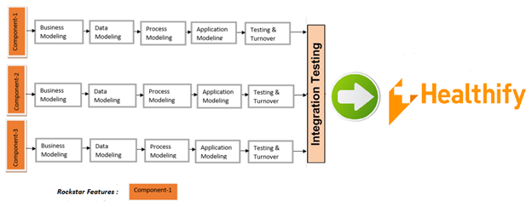
SDLC Model : RAD with Rockstar feature
Component -1: 360 degree profile view
Component -2: Virtual appointment
Component - 3: Connecting Pharmacy

Slide 63
Why RAD with Rockstar model ?
The features are independent of each other and their development stages can
be begun simultaneously or concurrently, hence we identified the model to be RAD
Since all the functionalities revolve around the entity patient, we identified
360 degree profile view as our rockstar feature

Slide 64
SDLC Steps

Slide 65
Requirement gathering and analysis:
Gathering Business requirements :- Conducted surveys for patients and doctors and identified the problem areas to be as follows:
Struggling to consolidate medical history
Difficulty in scheduling appointments and going for personal visits to hospital/Clinic
Inconviniency in collecting medicines from pharmacies
Analysis :- After researching about the alternatives, the team came to a mutual agreement that MongoDB fulfills the current requirements and will integrate with existing system perfectly

Slide 66

Test Plan
https://www.google.com/search?q=alpha+testing+and+beta+testing&source=lnms&tbm=isch&sa=X&ved=0ahUKEwj69vb80rbbAhXJwFQKHVxmBYAQ_AUICigB&biw=1707&bih=735#imgrc=BDKttIveE4Uw3M:

Slide 67
Internal Alpha
Initial alpha test will focus primarily on integration and system testing
Primary focus is on basic interaction between subsystems and interconnectivity of the various databases.
Minimum Feature requirement for Beta is working connections between the Medical Personnel, Patients, and Lab.
Pharmacy Access can be finalized in Beta.
Alpha will only focus on web browser access of systems, with support of latest Edge, Chrome, Firefox.
Mobile support to be a Beta Test Feature.

Slide 68
Beta Test
Pharmacy Access can be finalized in Beta.
Primary focus will be on System testing
System will be subject to stress testing
Heavy GUI testing with beta users of all persona types, for several iterations to ensure menus and work flows are simple and intuitive.
Heavy access also on Security. User permissions, access controls, and protections must be in place. No actual patient information to be used initially.

Slide 69
Beta Test Continued…
As security requirements are fully tested, user tests can start transitioning to using
live systems as testing nears release and Beta user scope can be increased.
All features must be fully operable and integrated, no high severity high impact bugs.

Slide 70
Bug Tracking

Slide 71
Bug Tracking
The system will be using Remedy[1] for bug tracking and long term service requests
Bugs will be tracked by Priority and Severity
Bugzilla will be used to manage changes
Initial focus will be on performance impacting bugs during Alpha and Beta stages
Post launch focus will shift more towards user features with a high emphasis on GUI and usability complaints to reduce overall incoming ticket volume
http://www.bmc.com/it-solutions/remedy-itsm.html https://www.bugzilla.org/

Slide 72
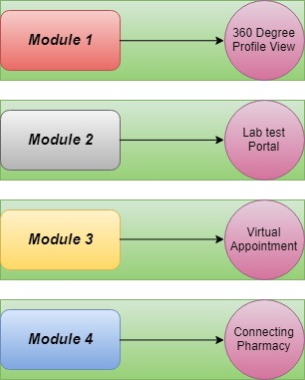
Implementation
All features(360 degree profile view, Virtual Appointments & Connecting parmacies)
being independent from each other, Teams will begin working on different features
simultaneously.

Slide 73
Release Criteria
The application should be supported by latest browsers such as Edge, Chrome,
Firefox and also through mobile platforms.
System should integrate with existing Healthify MySQL Database.
System should aggregate patient’s relevant medical history on demand.
System should accept updates to patient’s medical history via web form or file upload.
System should integrate with connected pharmacies’ inventory databases.
System should record and archive virtual appointments.

Slide 74
Release Criteria
All the bugs found in the testing phase should be documented and be resolved
All QA tests should run at 100% of expected coverage.
All acceptance tests must pass.
The application must be tested in beta phase for at least 100 hours
HTTP Responses complete within 300 milliseconds
System should be capable of supporting over 10,000 concurrent users

Slide 75
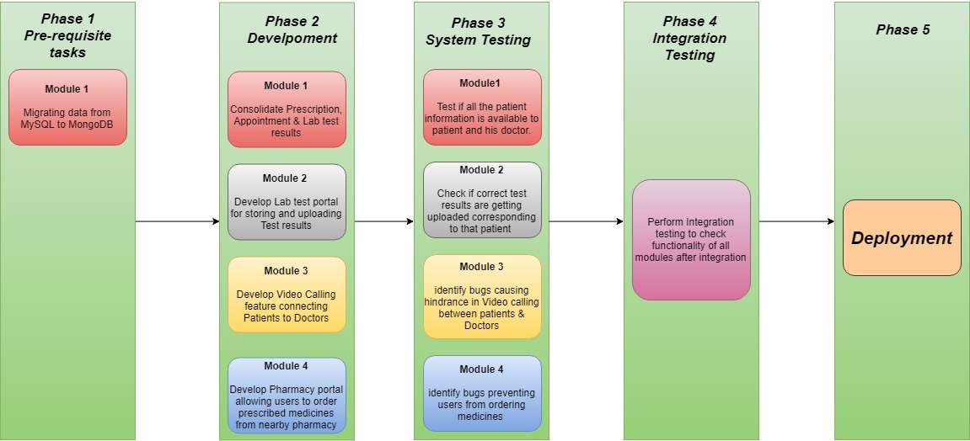
Deployment

Slide 76
Maintainance
After successful implementation and deployment, system will require support and assistance in case of issues
We will have our trained database administrator to provide assistance whenever required
Monitoring of servers and database is continuously done for ensuring the system availability

Slide 77

Company Roadmap
Phase 4:
Deploy the System to users
(June’18)
Phase 3:
Integrate all components and perform overall testing
(May’18-June’18)
Phase 2:
Begin Development of all components in Parallel
(April’18-May’18)
Phase 1:
Requirement
Gathering & Analysis
(April’18)
https://www.google.com/search?q=company+roadmap&source=lnms&tbm=isch&sa=X&ved=0ahUKEwjgnbPz4bbbAhUFFHwKHVpQBvwQ_AUICigB&biw=1707&bih=735#imgdii=LjfEP0OQqssCUM:&imgrc=it4x1X-_AOvFXM:

Slide 78
Risks and Mitigations

Slide 79
Risks and Mitigations
Risk | Severity | Mitigation
Data loss | High | Daily database backups via script Backups stored on “vault” machines built solely to store data and remain disconnected from main Healthify services

Slide 80
Risks and Mitigations (cont.)
Risk | Severity | Mitigation
Data breach | High | Database access permissions granted via MongoDB “Users and Roles” by in-house DBA Permission and access logs audited regularly by independent InfoSec Officer. Database server only accessible via Ethernet No remote access permissions Passwords should be reset regularly to strict standards

Slide 81
Risks and Mitigations (cont.)
Risk | Severity | Mitigation
Network Failure | High | Maintain backup internet connections from secondary ISPs Network admin should be capable of changing network configs to minimize downtime

Slide 82
Risks and Mitigations (cont.)
Risk | Severity | Mitigation
Internal Culture Resistance | Medium | Employees given training on new system to acclimate them to new system Address employee concerns during development & rollout

Slide 83
Risks and Mitigations (cont.)
Risk | Severity | Mitigation
Data not up-to-date | Low | Require regular updates of data via triggers Eg: A patient that hasn’t updated their vaccinations within a year will be notified to update vaccinations via secure web portal or request an appointment with primary doctor

Slide 84
Success Metrics
No. of concurrent user- system is able to concurrently handle traffic upto 10,000 users
Query response time- query response time is less than 300 ms
Virtual Appt - users are able to make virtual appoints with the doctor without any lag
Pharmacy - there is a increase in number of orders to the pharmacy and the waiting time is also reduced for the user as the user can send the prescription to the pharmacy using the application
Self service - users are able to book and reschedule appointments by using the application removing the need to call the doctor's office.

Slide 85
Business Values
Hassle free delivery of medicines at home
Increased revenue due to virtual appointments
Increased profits in terms of medicine sales from pharmacies
Reduce the potential for malpractice and improve healthcare

Slide 86
Benefits and Conclusion

Slide 87
Benefits
Increase patients served with convenient service, increase net profits
Improve internal workflow and consistent service
Improve stability and security with standardized and secure servers

Slide 88
Conclusion
At Healthify, our vision is to make health management easier and faster for patients by connecting them with doctors and pharmacies.
With our plan, we will create a modern and convenient system for patients, employees, and pharmaceutical partners.
With our new system, we will ensure more patients have access to the most advanced healthcare system available.

Slide 89
Thank You!

